Slide 1

Threads
Fatema Siddika

Slide 2

Threads are way for a program to divide(split) itself into two or more simultaneously running tasks.
In computer science, a thread of execution is the smallest sequence of programmed instructions that can be managed independently by an operating system scheduler.

Slide 3

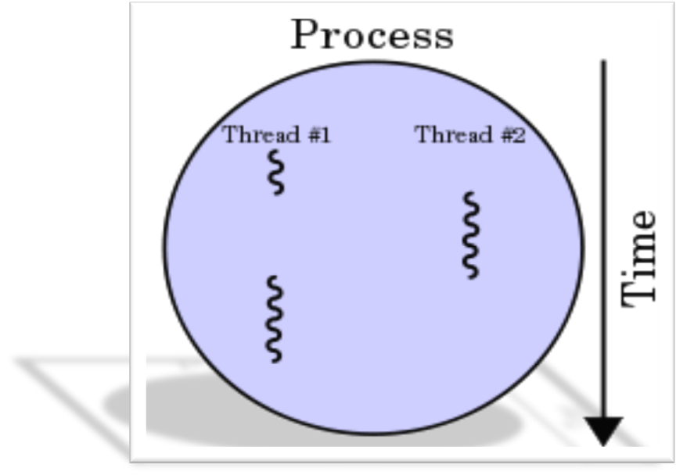
Fig: A process with two threads of execution on a single processor..

Slide 4

If we consider running a word processing program to be a process, then the auto-save and spell check features that occur in the background are different threads of that process which are all operating on the same data set (your document).Also it can have input accepting, processing and output producing threads.

Slide 5


A word processor with three threads

Slide 6

A thread is a basic unit of CPU utilization.
It comprises
1)a thread ID
2)a program counter(PC)
3)a register set
4)a stack
5) Thread specific data.

Slide 7


Each thread has its own stack

Slide 8

It shares with other threads belonging to the same process its
1)code section
2)data section
3)open files
4)signals
5) Program instructions

Slide 9



Slide 10

process
In computing, a process is an instance of a computer program that is being sequentially executed by a computer system that has the ability to run several computer programs concurrently.
So, In a word, A process is a program in execution.
Thread
A single process may contain several executable programs (threads) that work together as a coherent whole.

Slide 11


(a) Three processes each with one thread
(b) One process with three threads

Slide 12
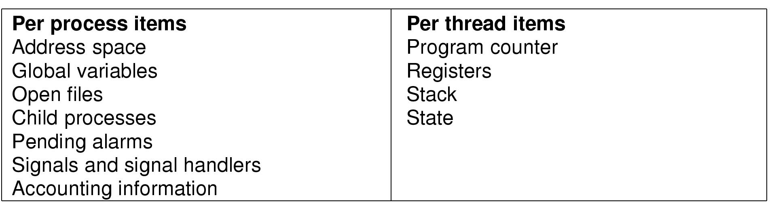
Items shared by all threads in a process
Items private to each thread

Slide 13
Threads and Processes
one process
one thread
one process
multiple threads
multiple processes
one thread per process
multiple processes
multiple threads per process

Slide 14
Threads vs. Processes
How threads and processes are similar
  Each has its own logical control flow
  Each can run concurrently
  Each is context switched
How threads and processes are different
  Threads share code and data, processes (typically) do not
  Threads are somewhat less expensive than processes
    Process control (creating and reaping) is twice as expensive as thread control

Slide 15
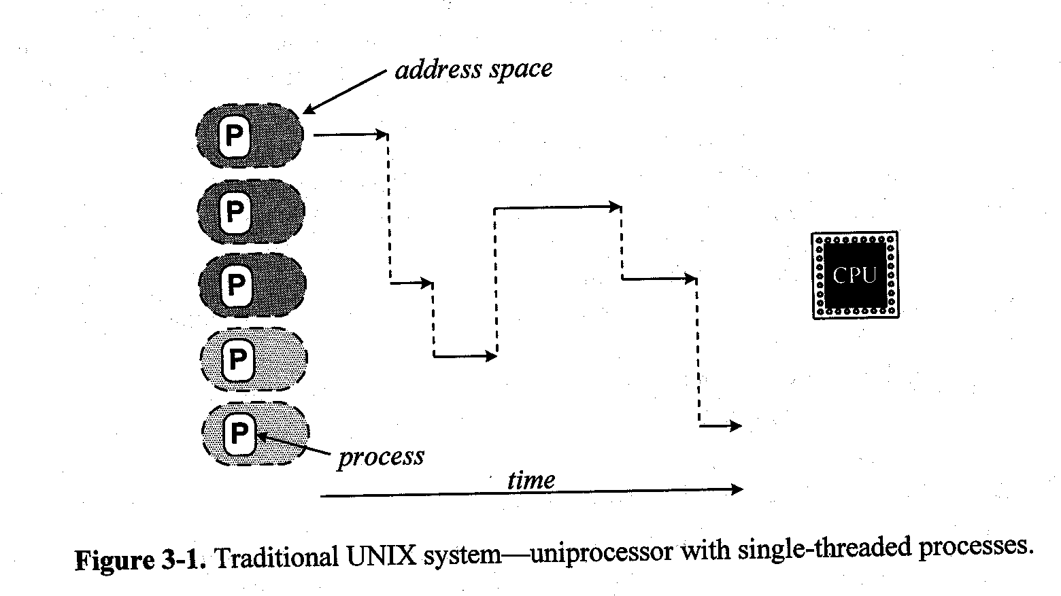
Traditional UNIX System

Slide 16
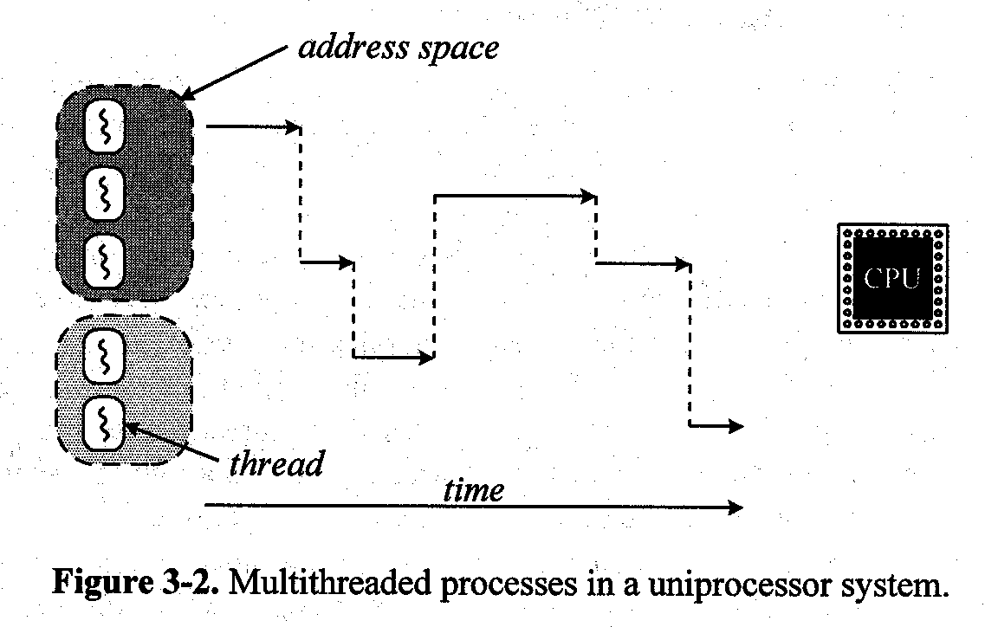
Multithreaded Processes

Slide 17
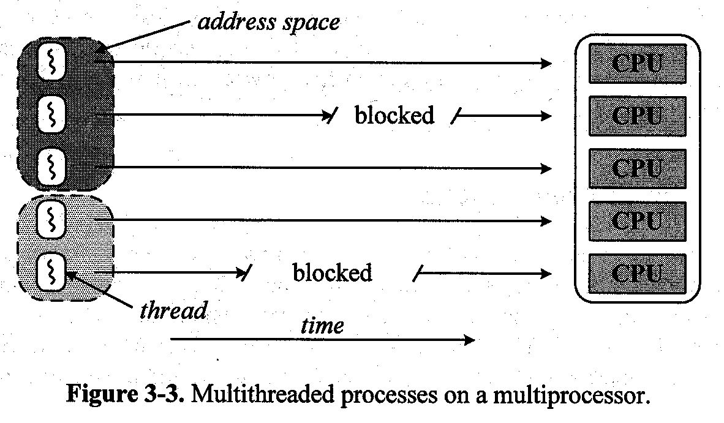
Multiprocessor

Slide 18
Benefits of Threads
Takes less time to create a new thread than a process
Less time to terminate a thread than a process
Less time to switch between two threads within the same process
Since threads within the same process share memory and files, they can communicate with each other without invoking the kernel
  Multitasking i.e.one process serves multiple clients

Slide 19
Drawbacks
  Not as widely available as longer established features
  Writing multithreaded programs require more careful thought
  More difficult to debug than single threaded programs
  For single processor machines, creating several threads in a program may not necessarily produce an increase in performance (only so many CPU cycles to be had)

Slide 20
Thread States
Primary states:
  Newborn(New),Running, Runnable, Blocked, Terminated(dead) .
Operations to change state:
  Spawn: new thread provided register context and stack pointer.
  Block: event wait, save user registers, PC and stack pointer
  Unblock: moved to ready state
  Finish: deallocate register context and stacks.

Slide 21
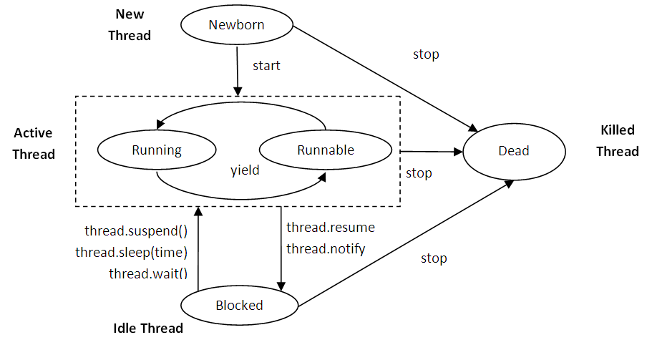
Thread States(cont.)

Slide 22
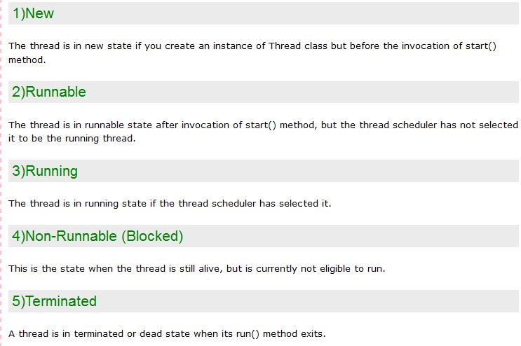
Thread States(cont.)

Slide 23
Multithreading Models
Many-to-One
One-to-One
Many-to-Many

Slide 24
Many-to-One
Many user-level threads mapped to single kernel thread
Examples:
  Solaris Green Threads
  GNU Portable Threads

Slide 25
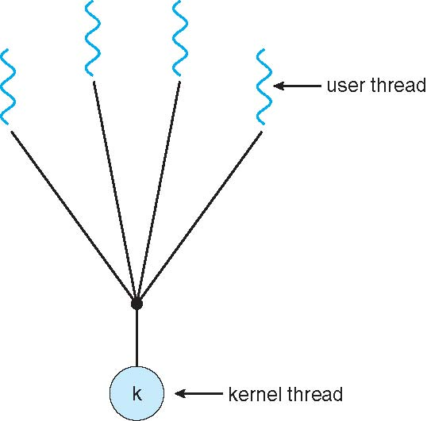
Many-to-One Model

Slide 26
One-to-One
Each user-level thread maps to kernel thread
Examples
  Windows NT/XP/2000
  Linux
  Solaris 9 and later

Slide 27
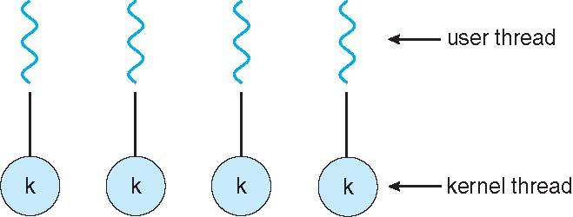
One-to-one Model

Slide 28
Many-to-Many Model
Allows many user level threads to be mapped to many kernel threads
Allows the operating system to create a sufficient number of kernel threads
Solaris prior to version 9
Windows NT/2000 with the ThreadFiber package

Slide 29

Many-to-Many Model

Slide 30
Kernel Threads
Supported by the Kernel
Examples
  Windows XP/2000
  Solaris
  Linux
  Tru64 UNIX
  Mac OS X

Slide 31
User Threads
Thread management done by user-level threads library
Three primary thread libraries:
  Java threads
  POSIX Pthreads
  Win32 threads

Slide 32
Java Threads
Java threads may be created by:
  Extending Thread class
  Implementing the Runnable interface
Java threads are managed by the JVM.

Slide 33

Java Thread States

Slide 34
Pthreads
May be provided either as user-level or kernel-level
A POSIX standard (IEEE 1003.1c) API for thread creation and synchronization
API specifies behavior of the thread library, implementation is up to development of the library
Common in UNIX operating systems (Solaris, Linux, Mac OS X)

Slide 35
Win32 Threads
Threads are an integral part of Windows 32-bit programming .
We must include the windows.h header file.
Threads are created in the Win32 API using the CreateThread() function.
The thread function for the Win32 API:
DWORD WINAPI MyThread (PVOID Param);
{//desired code;
}

Slide 36
Matrix Multiplication
Matrix multiplication is an important application in HPC and appears in many applications
Given two matrices A and B
  A matrix: M rows and K columns
  B matrix: K rows and N columns
  C matrix: the matrix product of A and B, in M rows and N columns
C = A * B

Slide 37
Example
A : a 3-by-2 matrix and B: a 2-by-3 matrix
A[M][K] = {{1,4},{2,5},{3,6}}
B[K][N] = {{8,7,6},{5,4,3}}
  C_{3,1} will be the sum of
    A_{3,1} X B_{1,1} and A_{3,2} X B_{2,1}

Slide 38
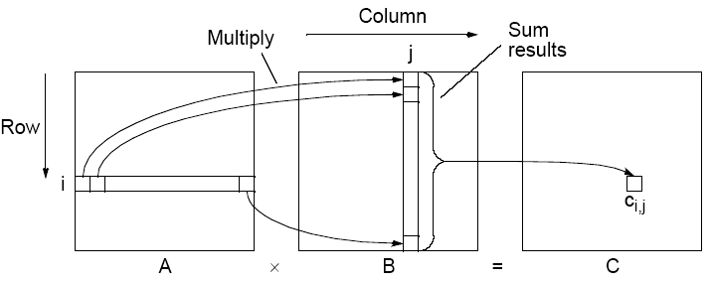

Matrix multiplication, C = A x B

Slide 39
Implementing Matrix Multiplication
Sequential Code
Assume matrices square (N x N matrices).
for (i = 0; i < N; i++)
for (j = 0; j < N; j++) {
c[i][j] = 0;
for (k = 0; k < N; k++)
c[i][j] = c[i][j] + a[i][k] * b[k][j];
}
Requires n³ multiplications and n³ additions
Sequential time complexity of O(n³).
Very easy to parallelize.

Slide 40
Effects of memory access in matrix multiplication
One thread is responsible for computing one result C_{ij} and needs access a row of A and a column of B:
Thread
Each thread access one row of A and one column of B
N² row/column combinations, N² threads

Slide 41
For Creating Thread in Windows
A thread in an executable that calls the C run-time library (CRT) should use the _beginthreadex and _endthreadex functions for thread management rather than CreateThread and ExitThread; this requires the use of the multithreaded version of the CRT. If a thread created using CreateThread calls the CRT, the CRT may terminate the process in low-memory conditions.

Slide 42
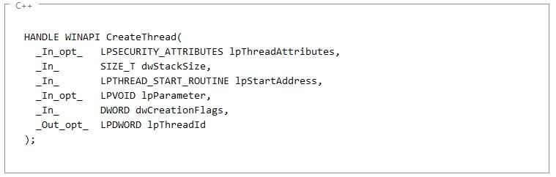

Creating Thread (CONT..)
Code in c++

Slide 43
Creating Thread (CONT..)
lpThreadAttributes [in, optional]
A pointer to a SECURITY_ATTRIBUTES structure that determines whether the returned handle can be inherited by child processes. If lpThreadAttributes is NULL, the handle cannot be inherited.
dwStackSize [in]
The initial size of the stack, in bytes. The system rounds this value to the nearest page. If this parameter is zero, the new thread uses the default size for the executable.
lpStartAddress [in]
A pointer to the application-defined function to be executed by the thread. This pointer represents the starting address of the thread.
lpParameter [in, optional]….A pointer to a variable to be passed to the thread.

Slide 44
Creating Thread (CONT..)
dwCreationFlags [in]
The flags that control the creation of the thread.
lpThreadId [out, optional]
A pointer to a variable that receives the thread identifier. If this parameter is NULL, the thread identifier is not returned.
Return value
If the function succeeds, the return value is a handle to the new thread.
If the function fails, the return value is NULL. To get extended error information, call GetLastError.

Slide 45
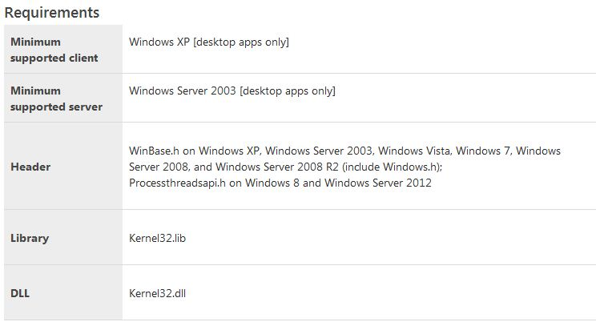
For Creating Thread(requirements)

Slide 46
Java Thread
Extending Thread:
public class MyThread extends Thread {
public void run() {
System.out.println("Thread executed!");
}
/* @param args the command line arguments */
public static void main(String[] args) {
MyThread thread = new MyThread();
thread.start();
}
}

Slide 47
Java Thread
When you implements Runnable , you can save a space for your class to extend any other class in future or now. Java doesn't support multiple inheritance, which means you can only extend one class in Java so once you extended Thread class you lost your chance and can not extend or inherit another class in Java.

Slide 48
Implementing the Runnable interface:
public class MyRunnable implements Runnable {
public void run() {
System.out.println("Thread executed!");
}
public static void main(String[] args) {
//create a Thread object and pass it an object of type Runnable
Thread thread = new Thread(new MyRunnable());
thread.start();
}
}

Slide 49
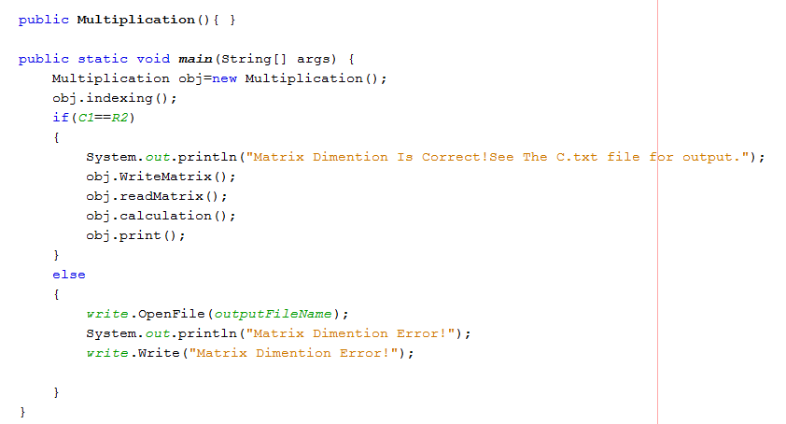
Implemented Code

Slide 50
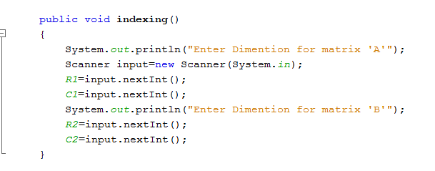

Slide 51
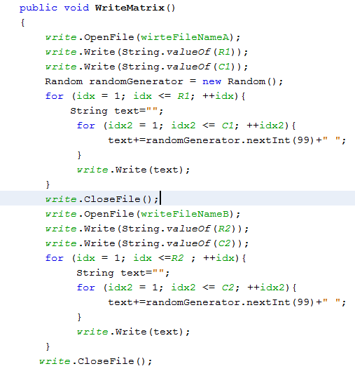

Slide 52
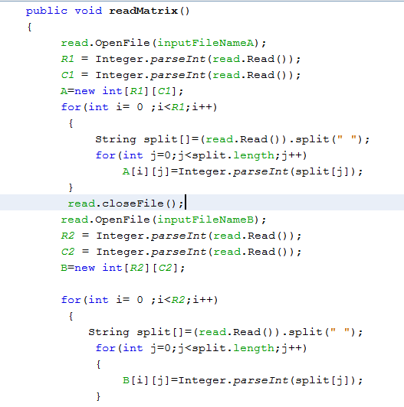

Slide 53
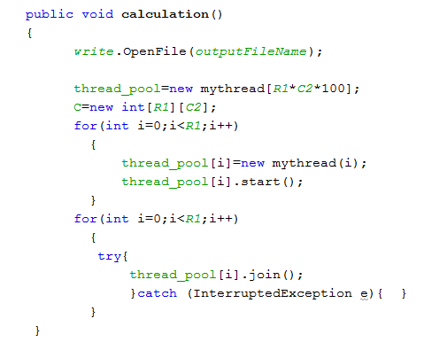

Slide 54
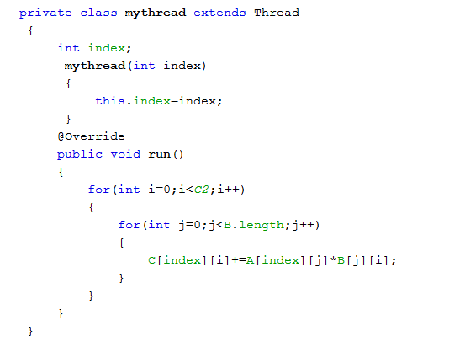

Slide 55
